Slide 1

Cloud Service Center Dashboard- 8/18/2020
Projects
Hours & Forecast
Migration
4
Upcoming
3
See next slide for details
BassPro is ramping up, and looks like it will be extended until mid-end of September
Elekta will likely have to be reduced in a week or two until migrations get started
Providence should start ramping up in the next week or two as applications are discovered and planned
Sandler Travis (STTAS)
Bass Pro
Elekta
Providence
Panasonic (LZ)
CDW (LZ)
Stone (LZ)
Landing Zone
4
Rolling Off / On Hold
1
Hussman
Flow Intl
Samaratan
Substantial
Estee
Stats
 | 2 weeks ago | Last Week | This Week | Next Week | 2 weeks out | 3 weeks out
Projects | 4 | 4 | 4 | 8 | 9 | 7
Mig VMs | 32 | 13 | 21 | N/P | N/P | N/P
Mig DBs | 0 | 0 | 0 | N/P | N/P | N/P
Other Work | 0 | 0 | 0 | N/P | N/P | N/P
21
Resources Scheduled
To Migrate
This week so far
Support
-
0
Updates / New Items
Blockers / Challenges
Improvement Items
Service Expansion
  In-Progress:
  Azure VMware Solution
  SQL Server/DB Migration Enhancements
  Managed Services Transition
  ALZ Engineering/Deployment
  WVD Quickstart Deployments
Estee – Awaiting change freeze to be lifted to perform partial DR test and handover. Marshall taking lead on this one. Scheduled for end of August.
Elekta – still waiting on them to get the landing zone functional. We can’t do full testing without it. Most of the planning complete, but migrations do not start for several weeks. Will be downtime.
Migration automation
  Full end to end automation
  Additional post-migration operations setup automation
  Getting the team to actually use the automation!
WVD deployment process documentation, scripts, automation, training

Slide 2
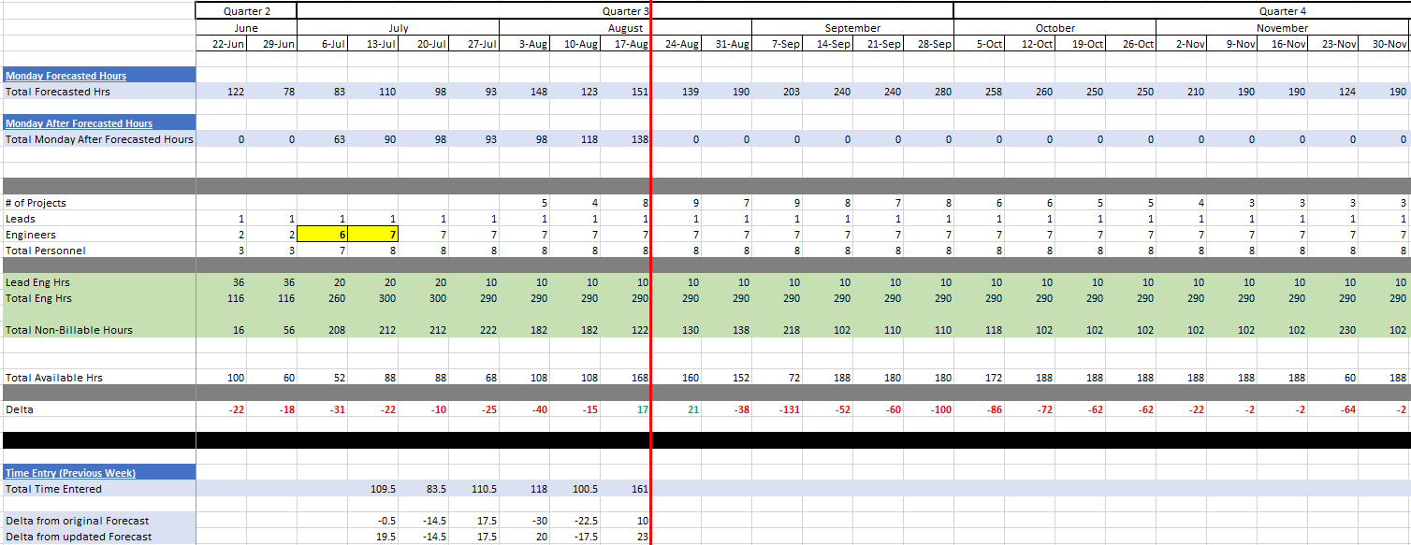

Slide 3
Cloud Service Center Metrics
CMC Utilization %
Forecast
Joe/Kyle billable 10hrs/wk+
Braiton/Martin billable 5-10hrs/wk+
Total Migrated Resources
CMC Utilization %
Actual Billed
Work Items by Client

